Slide 1

Analysis of People Killed
in Police Custody
Guided By : Prof. Khasha Dehnad
Team Members :
Reshma Manoj Kumar - 20007266
Sai Nikhil Mallakunta Babu Reddy - 10478524
Sai Vignesh Chiruvella - 20007437
Deepak Reddy Veeram Reddy - 20007581
CS 513 - A
KNOWLEDGE DISCOVERY & DATA MINING

Slide 2
Introduction
The purpose of this data mining project is to understand the people killed by police in the year 2015 in the United States.
We will use classification methods to analyze this data.
Nowadays, through methodologies like Artificial Intelligence and Machine Learning, it has become more easier to classify data accordingly and model the findings .
In this project we are going to use three different classification algorithms to classify the police custody deaths into two different categories based on
1. Race & Ethnicity of the people.
2. The States in which the people were killed
In this Project we are going to compare the results of each method and find the best algorithm for classification of police custody deaths.

Slide 3
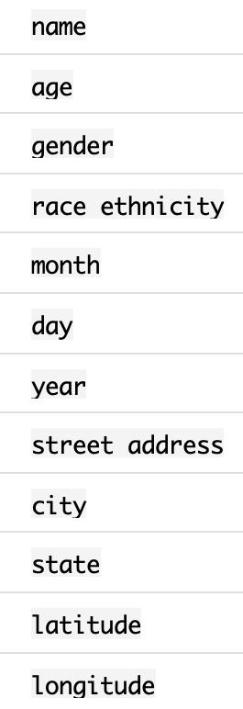
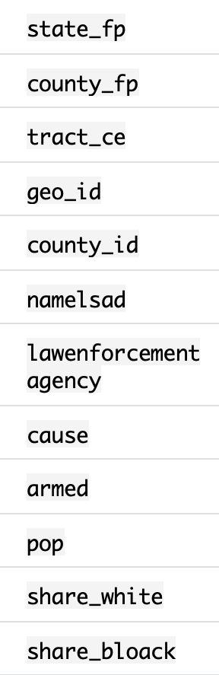
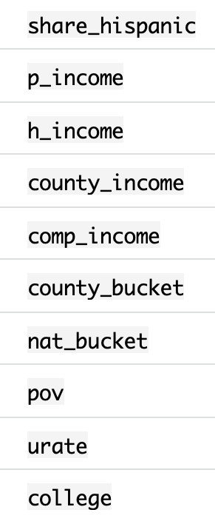
Dataset
Dataset contains nearly 467 rows and 34 columns and it is gathered from Kaggle.
Data has information about various causes of death of people killed in police custody.
Attributes

Slide 4
Classification of data
Here the splitting of data happens :
75 % - training data
25 % - testing data
The train dataset has 288 rows while the test dataset has 96 rows.
We use the class method because we predict a class.
Data -> TRAIN
Class Attribute -> Cluster

Slide 5
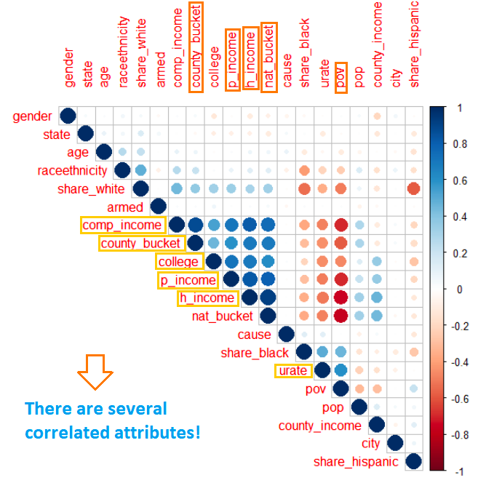
Correlation Matrix - Correlation between features
Correlation Matrix (Initial)

Slide 6
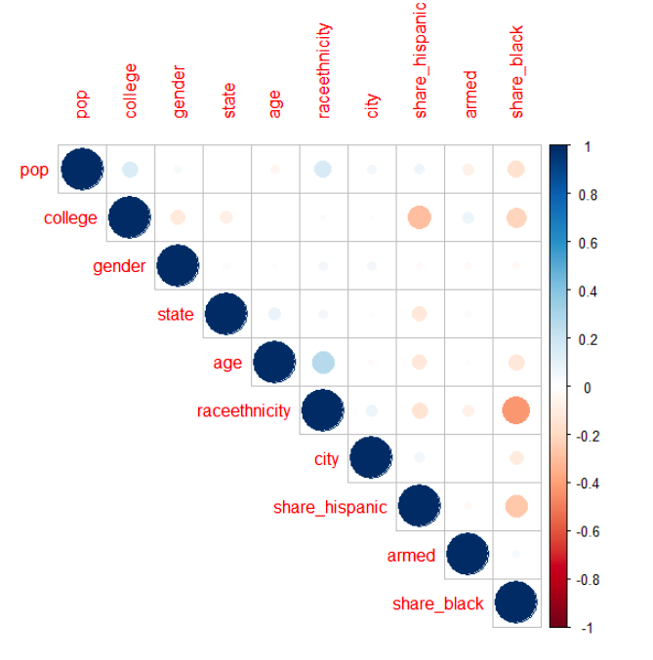
Correlation Matrix ( Final )

Slide 7
Classification Algorithms
1. ANN (Artificial Neural Networks)
2. Decision Trees
3. Random Forest

Slide 8

Artificial Neural Network (ANN)
An artificial neuron network or neural network is a
computational model that mimics the way nerve cells work
in the human brain.
ANN uses the learning algorithms that can independently make adjustments or learn them as they receive new input.
This is a very effective tool for non-linear statistical data modeling.

Slide 9
How ANN Works
ANN has dozens to millions of artificial neurons called units arranged in a series of layers. The input layer receives various forms of information from the outside world. This is the data that the network aims to process or learn about.
From the input unit, the data goes through one or more hidden units. The hidden unit’s job is to transform the input into something the output unit can use.
Result : There is no proper scalability as compared to other methods.

Slide 10
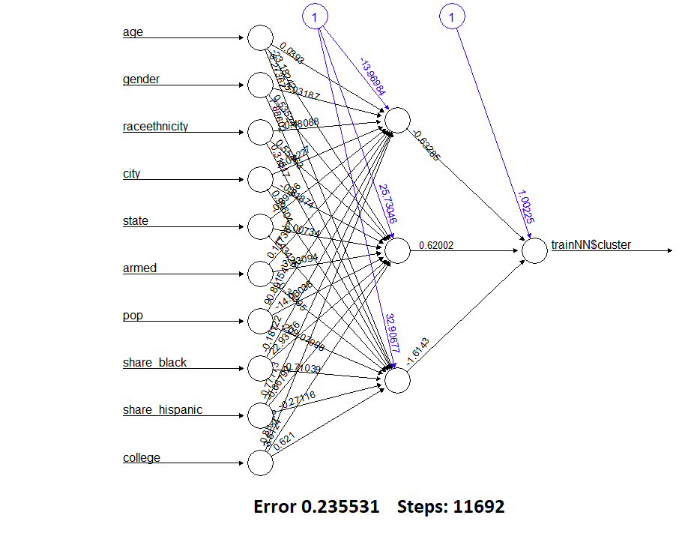
Plot of ANN

Slide 11
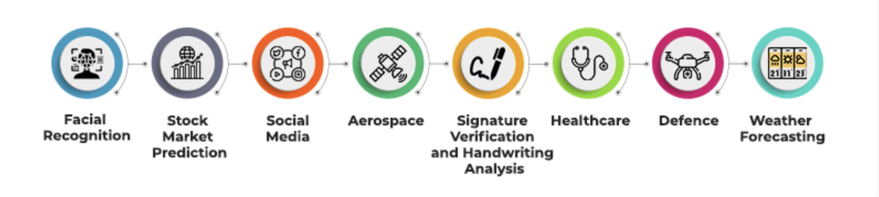
Applications of ANN

Slide 12
Decision Trees :
The Decision Trees algorithm is a part of the supervised learning algorithm family.
The decision trees approach, unlike other supervised learning algorithms, may also be utilized to solve regression and classification issues.
The purpose of employing a Decision Trees is to build a training model that can predict the class or value of the target variable by learning basic decision rules from past data .

Slide 13
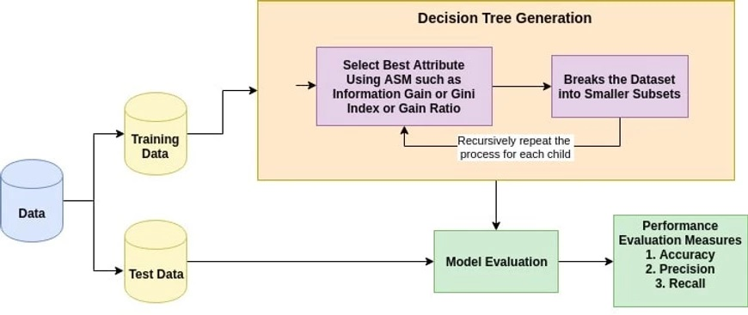
How Decision Tree Works
In Decision Trees, we begin at the root of the tree to forecast a class label for a record. The values of the root attribute are compared to the values of the record's attribute.
Based on the comparison, we follow the branch corresponding to that value and proceed to the next node. In the learning step, the model is developed based on given training data.

Slide 14
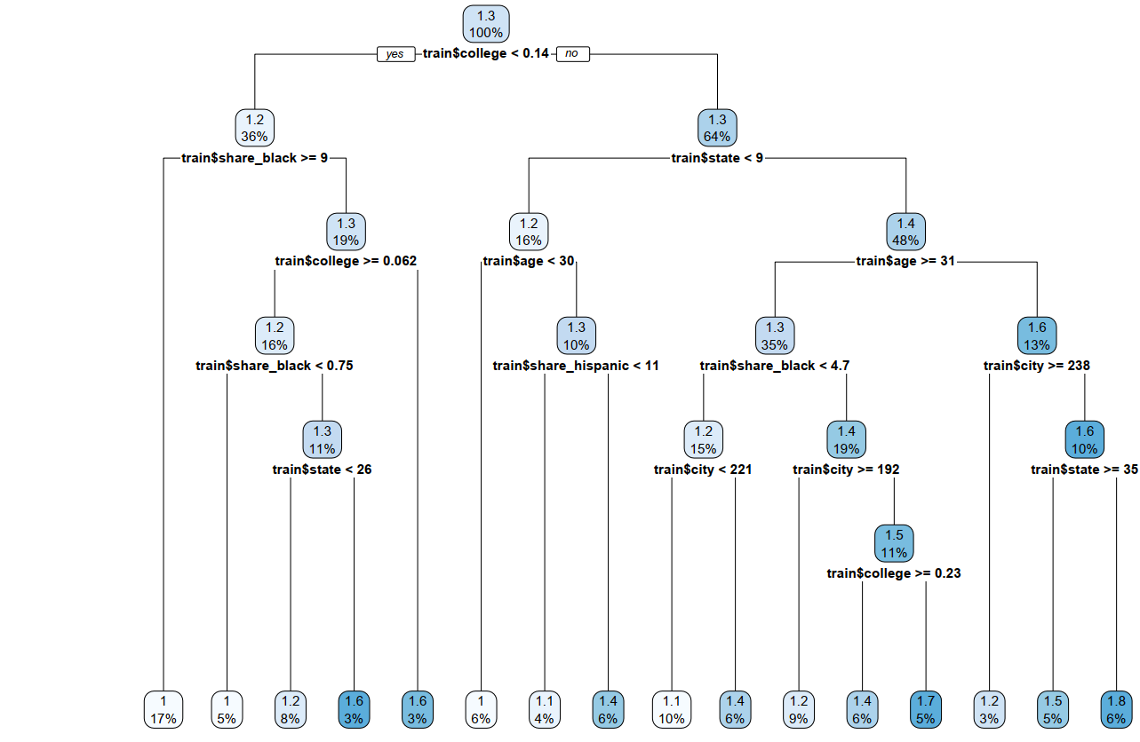
Plot of Decision Trees

Slide 15
Application of Decision Trees
In finance for option pricing.
Used by banks to classify loan applicants by their probability of defaulting payments.
Remote sensing is an application or area for pattern recognition based on decision trees.
Cerber Products, a popular baby product company use cecis on trees to decide.

Slide 16
Random Forest
Random forest is one of the most popular algorithms for regression problems (i.e. predicting continuous outcomes) because of its simplicity and high accuracy.
High accuracy
Scales well
Interpretable
Easy to use

Slide 17
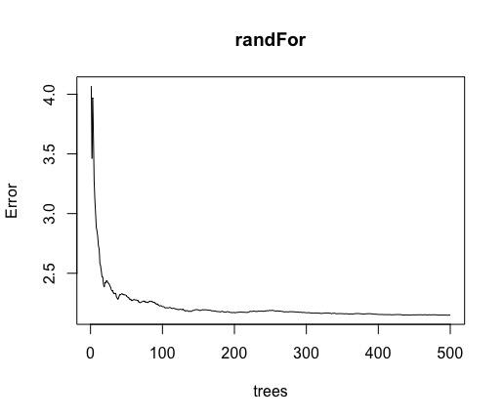
How Random Forest Works
Type of random forest: Regression
Number of trees: 500
No. of variables tried at each split: 3
Mean of squared residuals: 2.128844 %
Var explained: -8.31

Slide 18
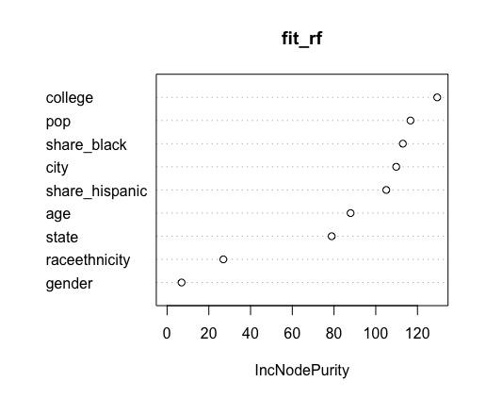
Variable importance plot - Random Forest
This is the variable importance plot measured
by Random forest.

Slide 19
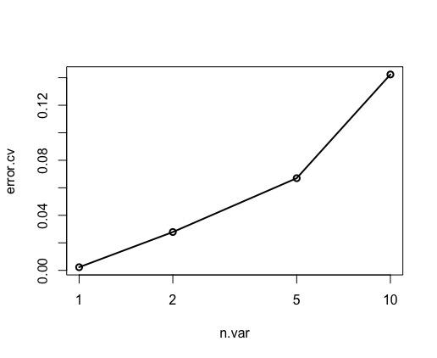
Random Forest Cross Validation Feature
This function shows the cross-validated prediction
performance of models with sequentially reduced.
Number of predictors (ranked by variable importance)
via a nested cross-validation procedure.

Slide 20
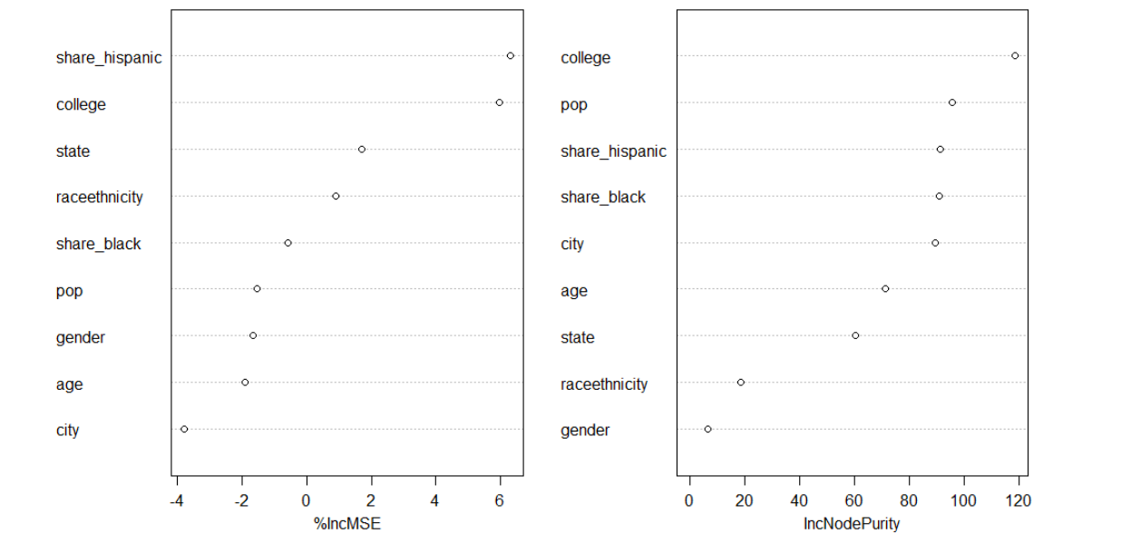
Plot of Random Forest

Slide 21
Applications of Random Forest
Banking Industry
Credit Card Fraud Detection
Healthcare and Medicine
Breast Cancer Prediction
Stock Market
Stock Market Prediction
E-Commerce
Product Recommendation

Slide 22
Clustering
The method of identifying similar groups of data in a dataset is called clustering. It is one of the most popular techniques in data mining.
Clusters used in the Project
K-means
Hierarchical Clustering (Agglomeration Method)

Slide 23
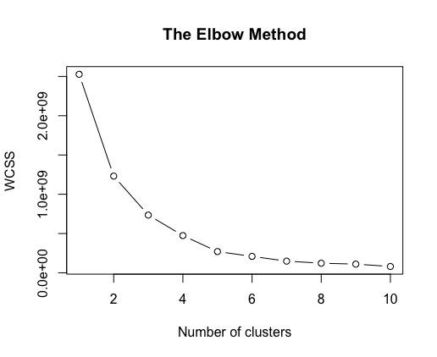
Elbow Method for Clustering
Plotting for Elbow Method, shows us the number of
clusters.
Elbow method is used to find the optimum number
of clusters and we can say that 6-8 is optimum number
of cluster from the plot.
However we will use 2 as k because we are looking
for Armed or Unarmed.

Slide 24
K–means Clustering :
K-Means Clustering is an unsupervised learning algorithm, which groups the unlabeled dataset into different clusters.
Here K defines the number of predefined clusters that need to be created in the process, as if K=2, there will be two clusters, and for K=3, there will be three clusters, and so on.
Steps in K-means
Step 1: Clean and Transform the Data
Step 2: Choose K and Run the Algorithm (here K value is taken as 2 )
Step 3: Review the Results
Step 4: Iterate Over Several Values of K

Slide 25
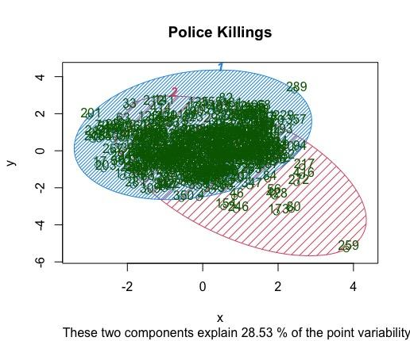
Plot of K-means
Here the clusters are based on
Armed Factor
Unarmed Factor
which define the people are armed or not.
Result : The results are not accurate with K-means.
Here the clusters are not defined well.
For better accuracy lets try Hierarchical Clustering

Slide 26
Hierarchical Clustering
Hierarchical clustering, is also known as hierarchical cluster analysis, is an algorithm that groups similar objects into groups called clusters. The endpoint is a set of clusters, where each cluster is distinct from each other cluster, and the objects within each cluster are broadly similar to each other.
Steps in Hierarchical Clustering
Step 1 : Identify the two clusters that are closest together,
Step 2 : Merge the two most similar clusters.
This iterative process continues until all the clusters are merged together.

Slide 27
Working of Hierarchical Clustering
hclust() and agnes() are two functions used for agglomerative hierarchical clustering (HC).
hclust() is the built-in R function for computing hierarchical clustering.
> hclust(d, method = "complete")
Desired value : Choose k=2.
We are cutting the dendrogram in order to create the desired number of clusters is 2 which means ARMED or UNARMED.

Slide 28
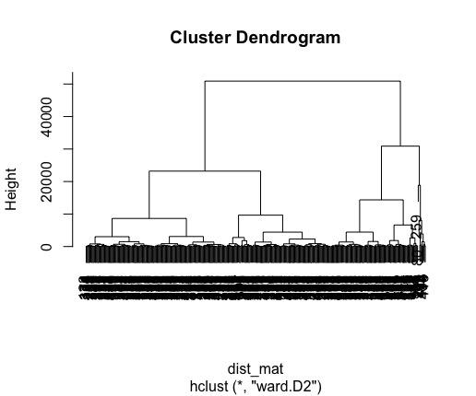
Plot of Hierarchical Clustering - Dendrogram
Results : Hierarchical Clustering gives better results compared to K-means.
cluster n
1 1 317
2 2 123
>

Slide 29
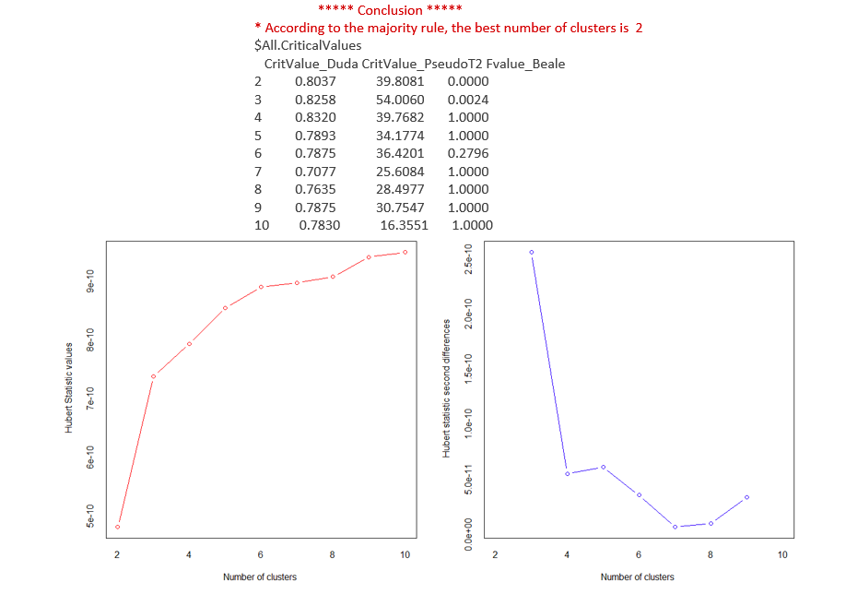
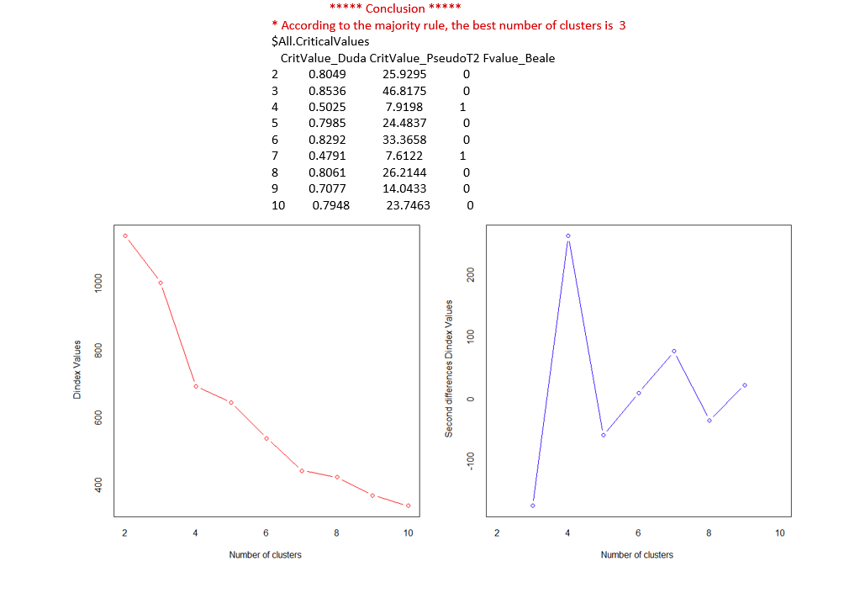
Comparison of K-means vs Hierarchical Clustering

Slide 30
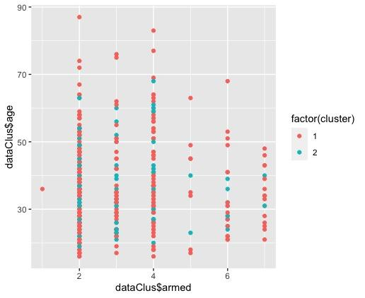
Clustering after Factoring

Slide 31
Conclusion
This project analyses the number of people who are killed in Police Custody in 2015. They are classified on the basis of race ethnicity and state using three classifiers. Random Forest classifier showed the accurate result compared to Decision Tree and ANN. The clusters are formed based on people killed in custody are divided into two clusters such as ‘armed’ and ‘unarmed’. Here K-means is a failure based on the results. Hierarchical clustering gave the best results according to the findings.
With detailed analysis we can get to know the most common crime that is committed and police can take the necessary action to minimize the particular crime rate.

Slide 32


